Slide 1
Vagrant 101
An Introduction

Slide 2
Overview
Why Vagrant
Terminology
Setup
Demo
Advanced Topics
Resources

Slide 3
What is Vagrant?
VM management tool
Automates the setup of your development environment

Slide 4
Has this happened to you?

Slide 5
New hire
Someone joins your project…
They pick up their laptop…
Then spend the next 1-2 days following instructions on setting up their environment, tools, etc.

Slide 6
Instead, lets do this.

Slide 7
New hire
Someone joins your project…
They pick up their laptop…
Then spend the next 20 minutes running a script which sets their environment up for them.

Slide 8
Other Benefits
Speed of building VMs
VMs become more disposable
"cattle vs pets”
Ability to automate VM customization
Admin rights in “locked down” environments
Versioned history for VagrantFiles
No internet required in some scenarios

Slide 9
Ecosystem & Terminology

Slide 10
Vagrant Ecosystem & Expectations
Big
Easy to get stuck down in the weeds
Let’s focus on the basics & “80/20” results
Productive in Vagrant = quick Expert in Vagrant = not quick
Notes:
Multiple ways to make/use all 3 components (VagrantFile, Boxes, & VM Provider)
We’ll save that talk for later on (202 section)

Slide 11
Vagrant Terms
Host The laptop/desktop OS that runs Virtualbox + Vagrant.
Virtual Machine / “VM” / “Guest” The virtual machine OS running within the host.
Vagrant An application that automates the setup of VMs.
VirtualBox An application to run VMs on your Host OS.

Slide 12
Vagrant Terms
Vagrantfile A set of Ruby instructions to Vagrant on how to build and configure a VM. Small Ruby file
Vagrant Box / “Base box” A template for a Virtual Machine. Large file containing the OS
Atlas - online host for pre-built Vagrant Boxes

Slide 13
VM
Vagrant Box
VirtualBox App
VagrantFile

Slide 14
Quick VM Set-up
Prerequisites
Pre-made VagrantFile & Box
Create & Launch the VM

Slide 15
Prerequisites
Virtualbox installed
Vagrant installed
VagrantFile (pre-made for Rails)
Notes:
Both Virtualbox and Vagrant have great, simple installation instructions.

Slide 16
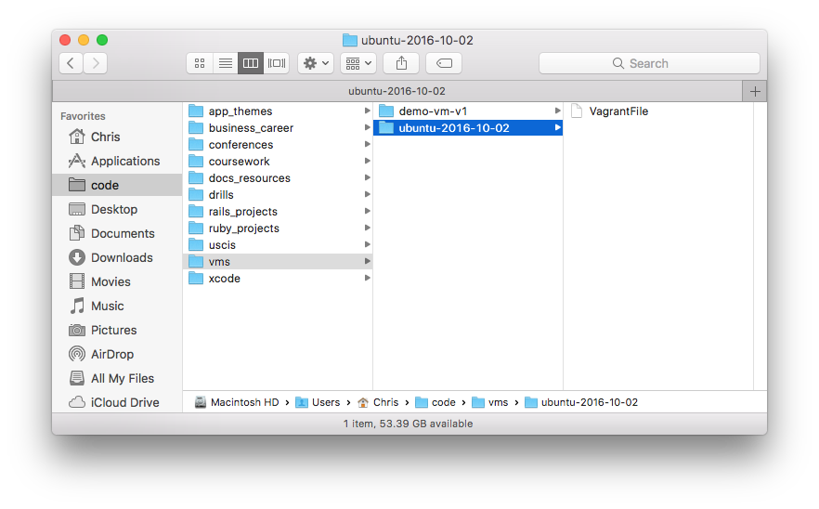
Place VagrantFile inside a working directory

Slide 17
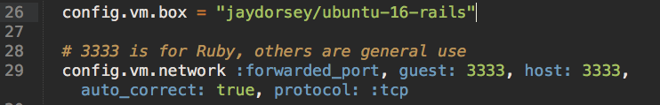
What’s In a VagrantFile?

Slide 18
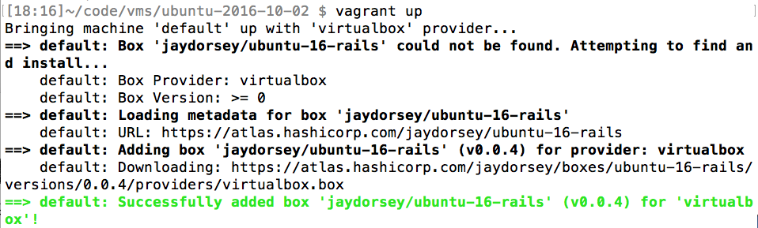
Launch the Vagrant VM
$ cd code/vms/ubuntu-2016-10-02
$ vagrant up

Slide 19
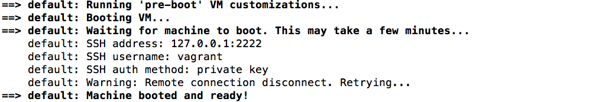
Launch the Vagrant VM
Vagrant VM is ready

Slide 20
Jay’s Vagrant Box Includes:
Ubuntu 16.04
Ruby 2.3.1
Postgres 9.6
Git 2.9
Chrome
Sublime Text
other apps...

Slide 21
Using Your New VM
CLI via SSH
GUI via VirtualBox
Shared Folders

Slide 22
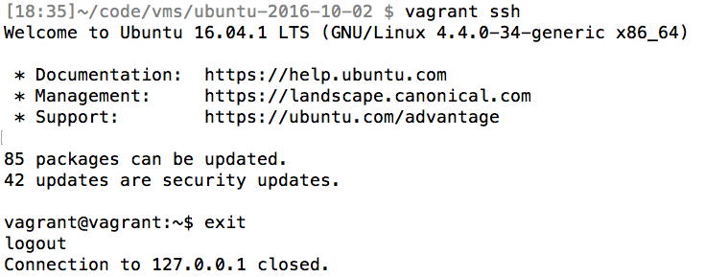
CLI via SSH
$ vagrant ssh

Slide 23
Install Apps
$ sudo apt-get install ...

Slide 24
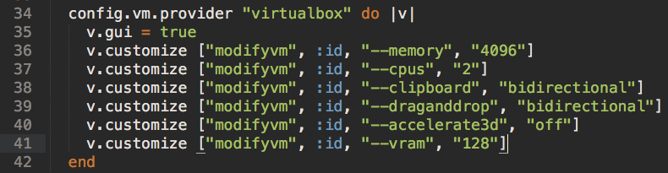
GUI via VirtualBox
Configs in VagrantFile...

Slide 25
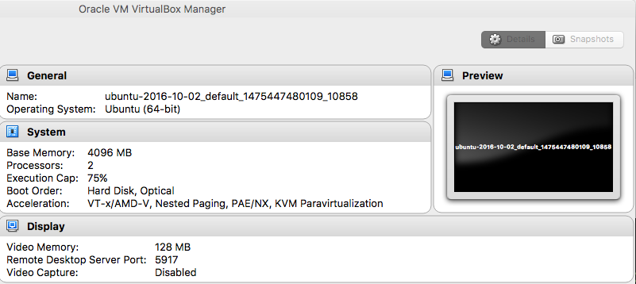
GUI via VirtualBox
...show up in VirtualBox

Slide 26
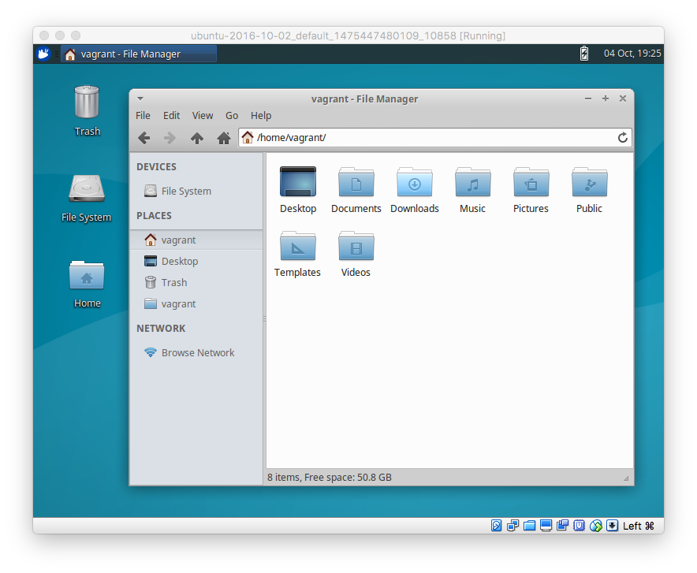
Your New Workstation

Slide 27
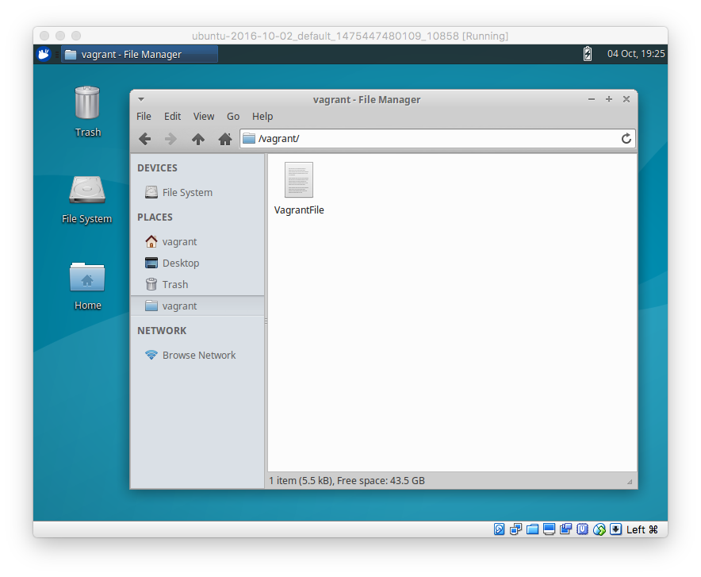
Shared Folders

Slide 28
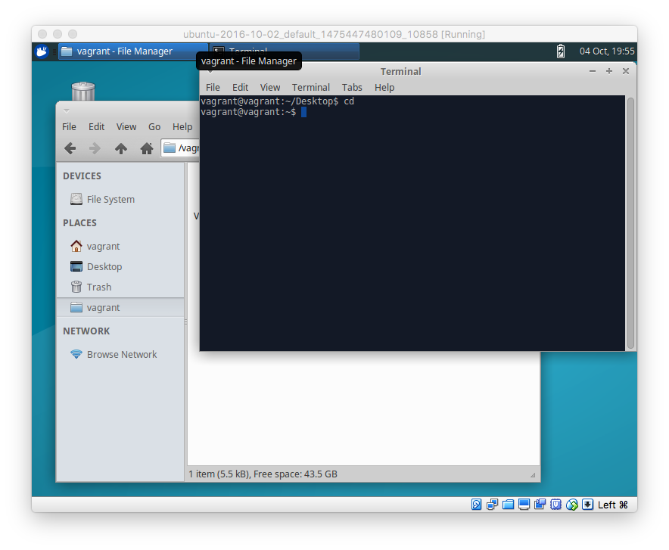
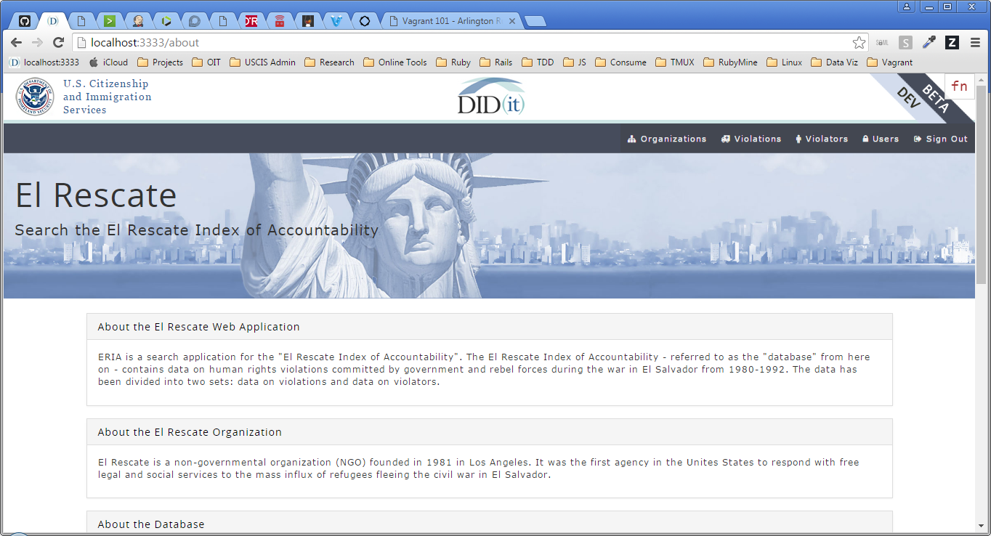
Workflow Due to Proxy
Host = Browser
VM = Everything Else
Terminal, Editor, etc.

Slide 29
Stop Your VM

Slide 30
Demo
Notes:
- Vagrant Box List
- Vagrant Up
SSH
ruby, rvm –v
exit
GUI
folder structure
shared folders
Guest Additions – see wiki
“Seamless” mode – Right CNTRL + L
see wiki for auto-login, menubar apps etc
Run ERIA
Browser – Windows
All else – VM
Vagrant Halt (NOT via GUI)

Slide 31
Customization
Choosing a Box
Modifying a Box

Slide 32
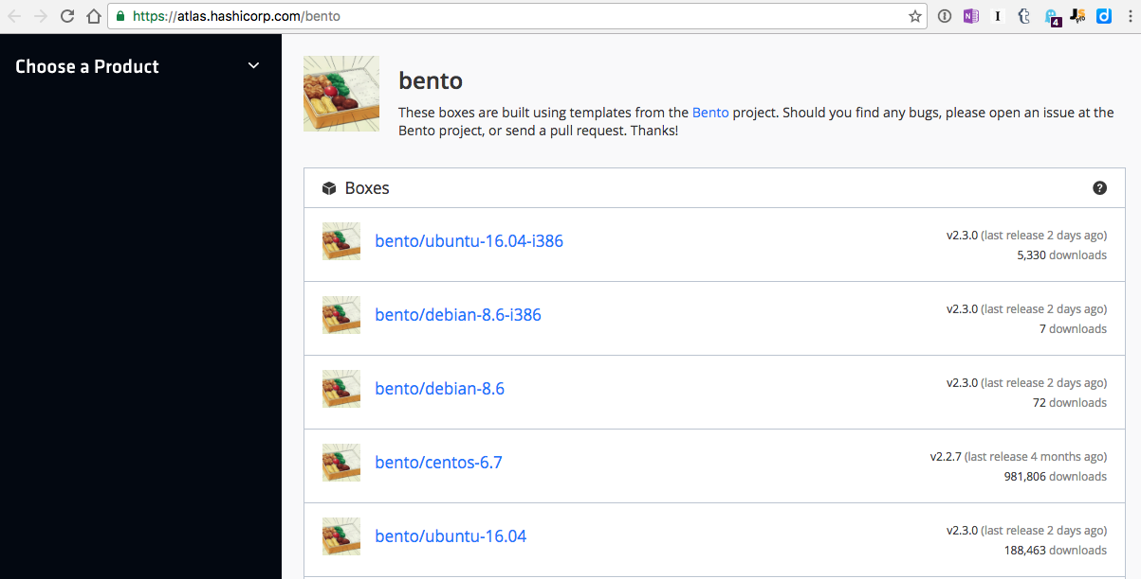
Basic = Bento Boxes (Atlas)

Slide 33
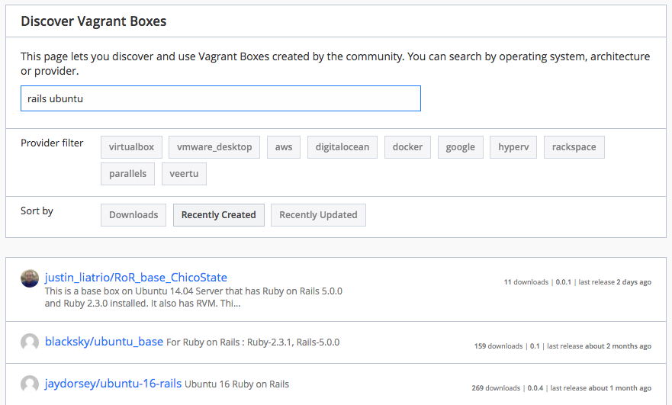
“Pre-Made” = Atlas Search

Slide 34
Modifying Boxes
Manual Changes
Easiest
Repetitive
Can get outdated quickly
Automated Changes
Learning curve (Chef)
Automated
Uses new versions (when built)

Slide 35
Standard practice
Start with a base-box of choice.
Bento boxes recommended
32 bit vs 64 bit
Add a Vagrantfile.
`vagrant init` will give you a blank template
Configure the Vagrantfile.
Hostname, network adapters, config paths…
Add Chef recipes as desired
Kinda like ruby gems
Can use to add RVM, install apps etc.
Great tutorial
https://gorails.com/guides/using-vagrant-for-rails-development

Slide 36
Summary

Slide 37
Vagrant…
Automates the setup and installation of a local dev VM.
Create a fully-configured ready-to-go VM in minutes.
Basic usage doesn't need any new skills.
Advanced configuration possible Chef, Packer etc.
To get started:
Install Vagrant + VirtualBox
Download a “pre-made” VagrantFile
`vagrant up`

Slide 38
FAQ
Docker vs Vagrant?
Complex Question
Docker is for running “containers” (with Apps inside them)
Vagrant is for running full-blown VMs (with guest OS inside them)
Good StackOverflow answer from creators of both apps:
http://stackoverflow.com/questions/16647069/should-i-use-vagrant-or-docker-for-creating-an-isolated-environment
Security of pre-built boxes?
If concerned, pick from Bento boxes or other known boxes
How do I create my own base box?
See “Vagrant 303” slides at end of this deck

Slide 39
Key resources
This presentation - https://github.com/ckib16/vagrant_101
USCIS Wiki - https://git.uscis.dhs.gov/USCIS/didit_onboarding/wiki
Virtualbox - https://www.virtualbox.org/
Vagrant - http://vagrantup.com/
Atlas Box Search - https://atlas.hashicorp.com/boxes/search
Bento Base Boxes - https://atlas.hashicorp.com/bento
Chef resources - http://www.opscode.com/chef/
Tutorial - http://learn.onemonth.com/how-to-setup-vagrant-for-rails
Packer - https://www.packer.io/
Packer + Vagrant Docs
https://atlas.hashicorp.com/help/packer/artifacts/creating-vagrant-boxes

Slide 40
Slide Sources
SIides referenced for this presentation
http://www.slideshare.net/MicheleOrselli/vagrant-for-real
http://www.slideshare.net/manarth/vagrant-crash-course

Slide 41
Thanks!
Chris Kibble
@ckib16

Slide 42
Creating your own Base Box

Slide 43
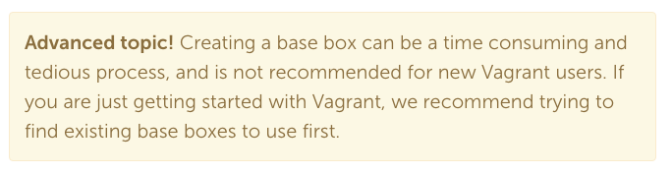
Danger!

Slide 44
Why create a base box?
More flexibility than Chef alone
Trusted source
Specific version of O/S

Slide 45
The Many Paths of Vagrant
Base Box
VagrantFile
Custom VM
Start With...
Modify the...
Result...
Optional `vagrant package`
Custom Base Box
Running VM Itself
Using...
Chef, etc.
Manual Changes
Custom VM
Custom Base Box
Packer Template
Chef, etc.
Custom Base Box
Packer

Slide 46
The Many Paths of Vagrant
Base Box
VagrantFile
Custom VM
Start With...
Modify the...
Result...
Optional `vagrant package`
Custom Base Box
Running VM Itself
Using...
Chef, etc.
Manual Changes
Custom VM
Custom Base Box
Easy
Hard
Packer Template
Chef, etc.
Custom Base Box
Packer

Slide 47
The Many Paths of Vagrant
Base Box
VagrantFile
Custom VM
Start With...
Modify the...
Result...
Optional `vagrant package`
Custom Base Box
Running VM Itself
Using...
Chef, etc.
Manual Changes
Custom VM
Custom Base Box
Easy
Hard
“Real-time” builds. Not “pre-made”
Packer Template
Chef, etc.
Custom Base Box
Packer

Slide 48


Packer & Atlas Intro
Packer – builds Vagrant Boxes
Atlas – hosts Vagrant boxes online (free)
“Creating Vagrant Boxes with Packer”
https://atlas.hashicorp.com/help/packer/artifacts/creating-vagrant-boxes

Slide 49
Box Packaging Tradeoffs
“Real-time” boxes using Chef in VagrantFile
“Pre-made” boxes built with Packer or `vagrant package`
Smaller base-box.
Requires internet access to build.
Always fetches latest version of the packages.
More time – each VM “built from scratch”
Larger base-box.
Ready to go without needing internet access.
Packages may become out-of-date.
Less time – VM is already per-made
Packer is hard to start but probably easiest over long term to manage a box

Slide 50
The Many Paths of Vagrant
Pre-made Base Box
VagrantFile
Custom VM
Custom Base Box
Start With...
Modify the...
Result...
Optional `vagrant package`
Custom Base Box
Running VM Itself
Using...
Chef, etc.
Chef, etc.
Manual Changes
Custom Base VM
Custom Base Box
Packer Template

Slide 51
The Many Paths of Vagrant
Pre-made Base Box
VagrantFile
Custom VM
Packer Template
Custom Base Box
Start With...
Modify the...
Result...
Optional `vagrant package`
Custom Base Box
Running VM Itself
Using...
Chef, etc.
Chef, etc.
Manual Changes
Custom Base VM
Custom Base Box
Easy
Hard

Slide 52
The Many Paths of Vagrant
Pre-made Base Box
VagrantFile
Custom VM
Packer Template
Custom Base Box
Start With...
Modify the...
Result...
Optional `vagrant package`
Custom Base Box
Running VM Itself
Using...
Chef, etc.
Chef, etc.
Manual Changes
Custom Base VM
Custom Base Box
“Real-time” builds. Not “pre-made”
Easy
Hard

